Slide 1



Independent work App
Reporter:Pragnesh Koli
Reporter:Krushali
Reporter:Krupesh
Department:B.C.A.
Department:B.C.A.
Department:B.C.A.

Slide 2
CONTENTS:
Part Ⅰ: Content of work
Part Ⅱ : Results of work

Slide 3
Part Ⅰ
Content of work

Slide 4
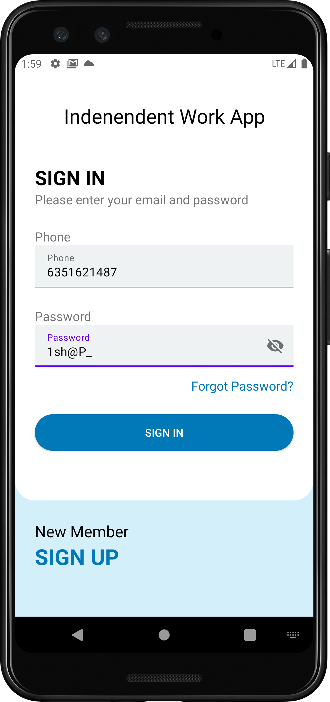
Login Activity

Slide 5
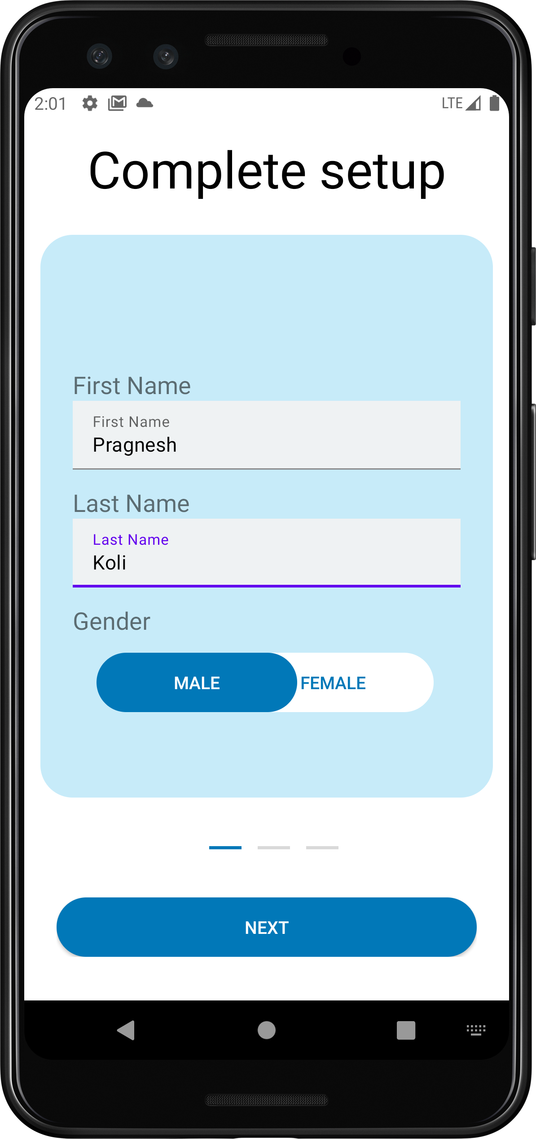
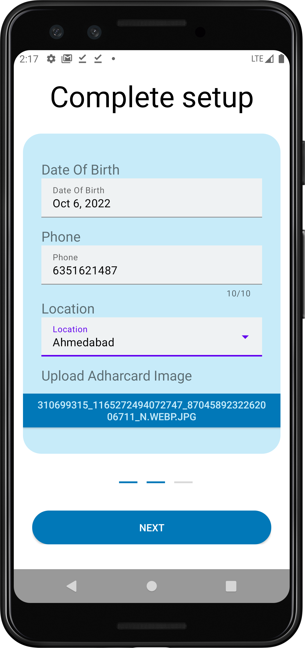
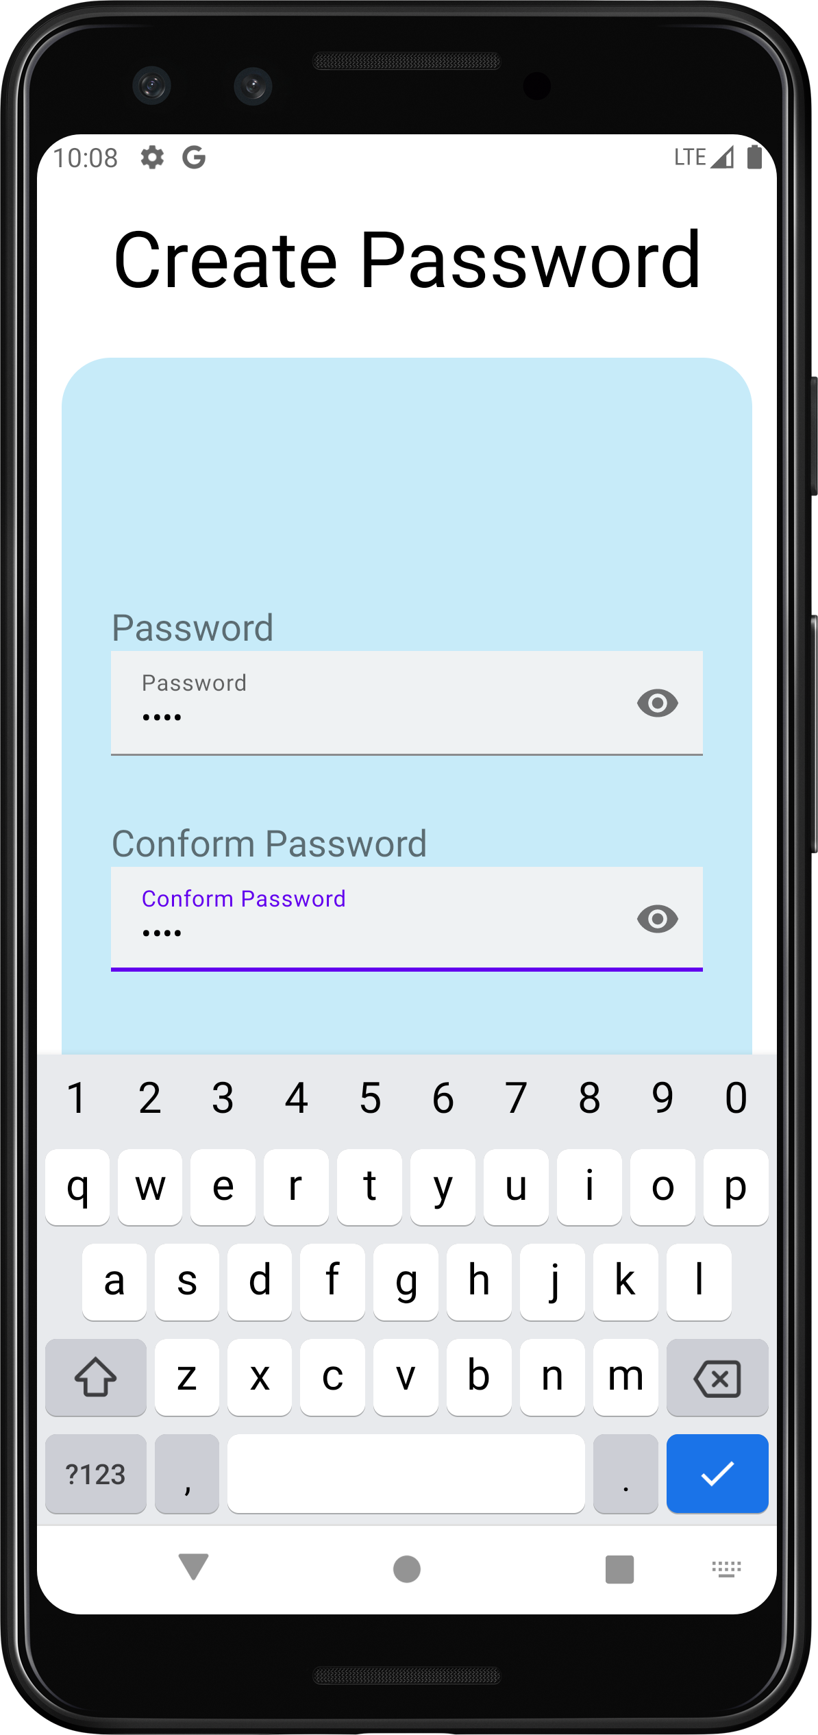
Sign Up Activity
Next
Next

Slide 6
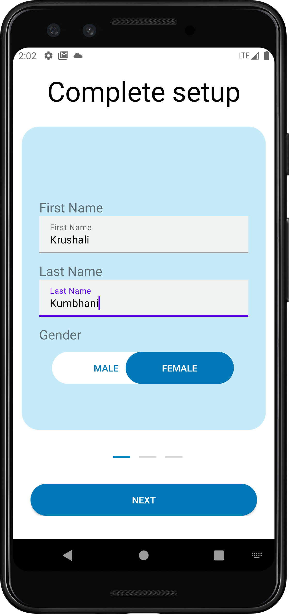
Sign Up Activity1

Slide 7
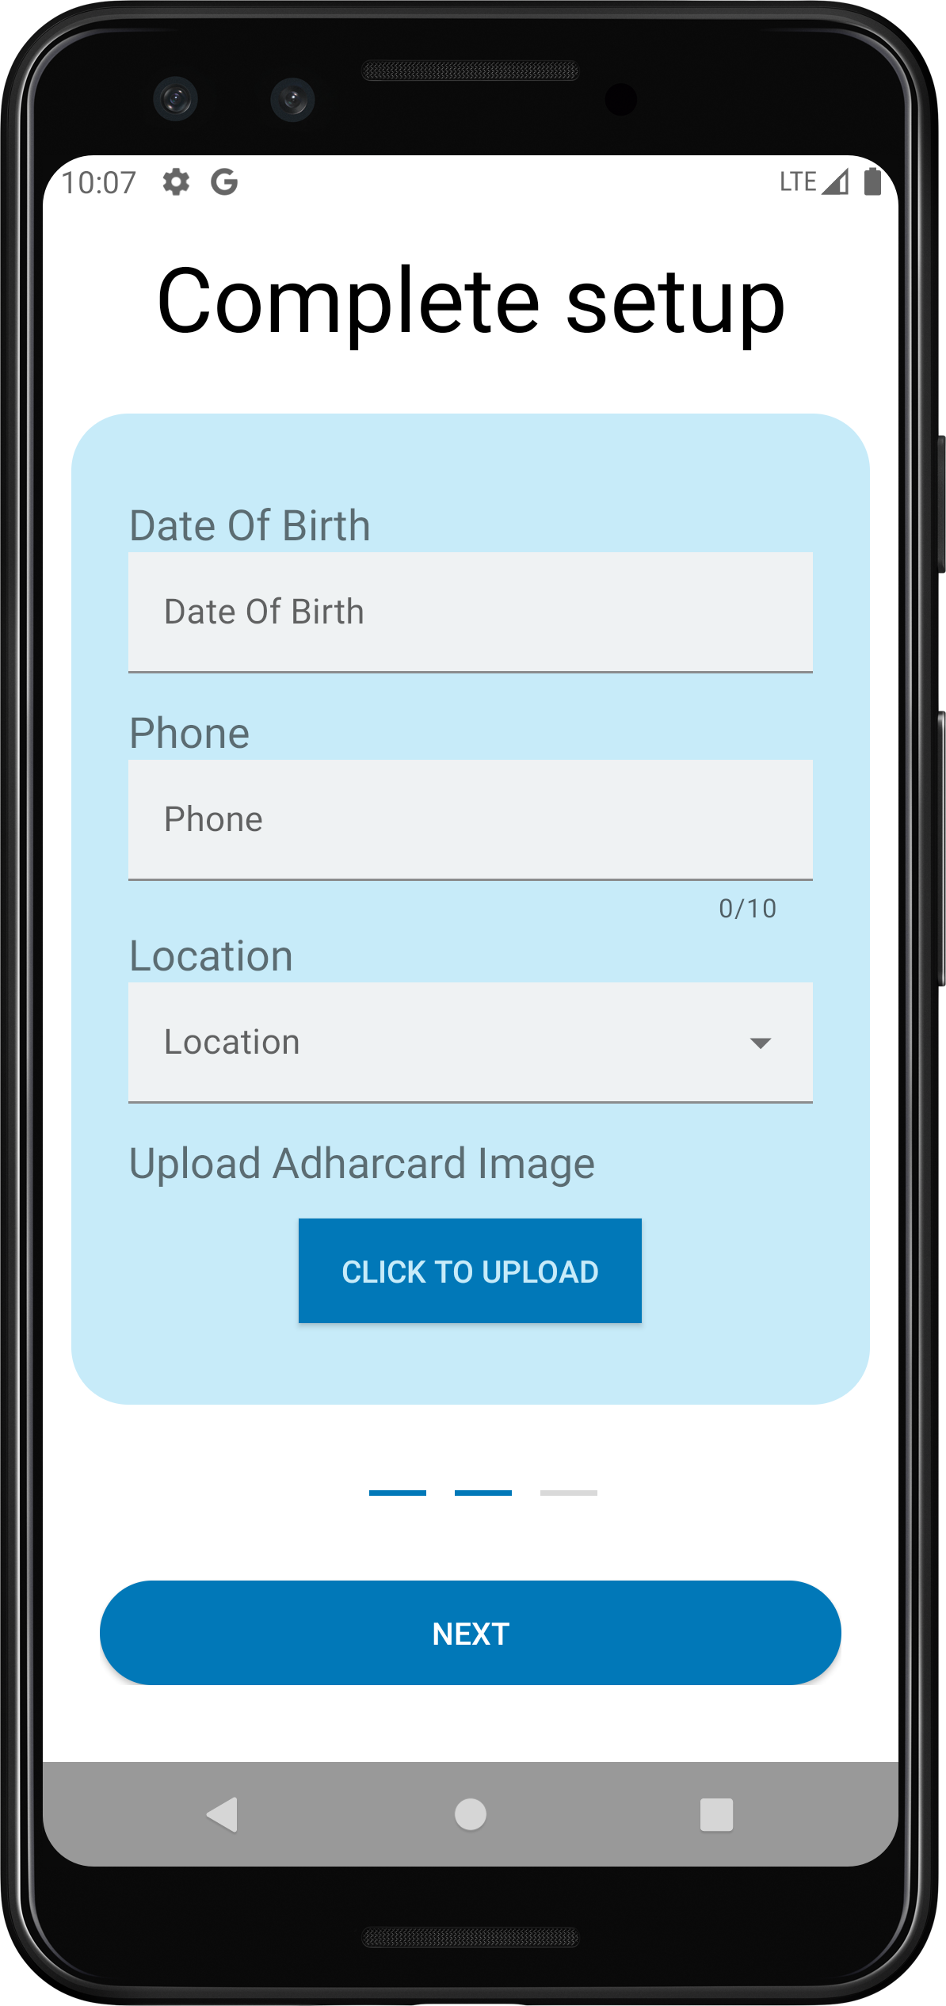
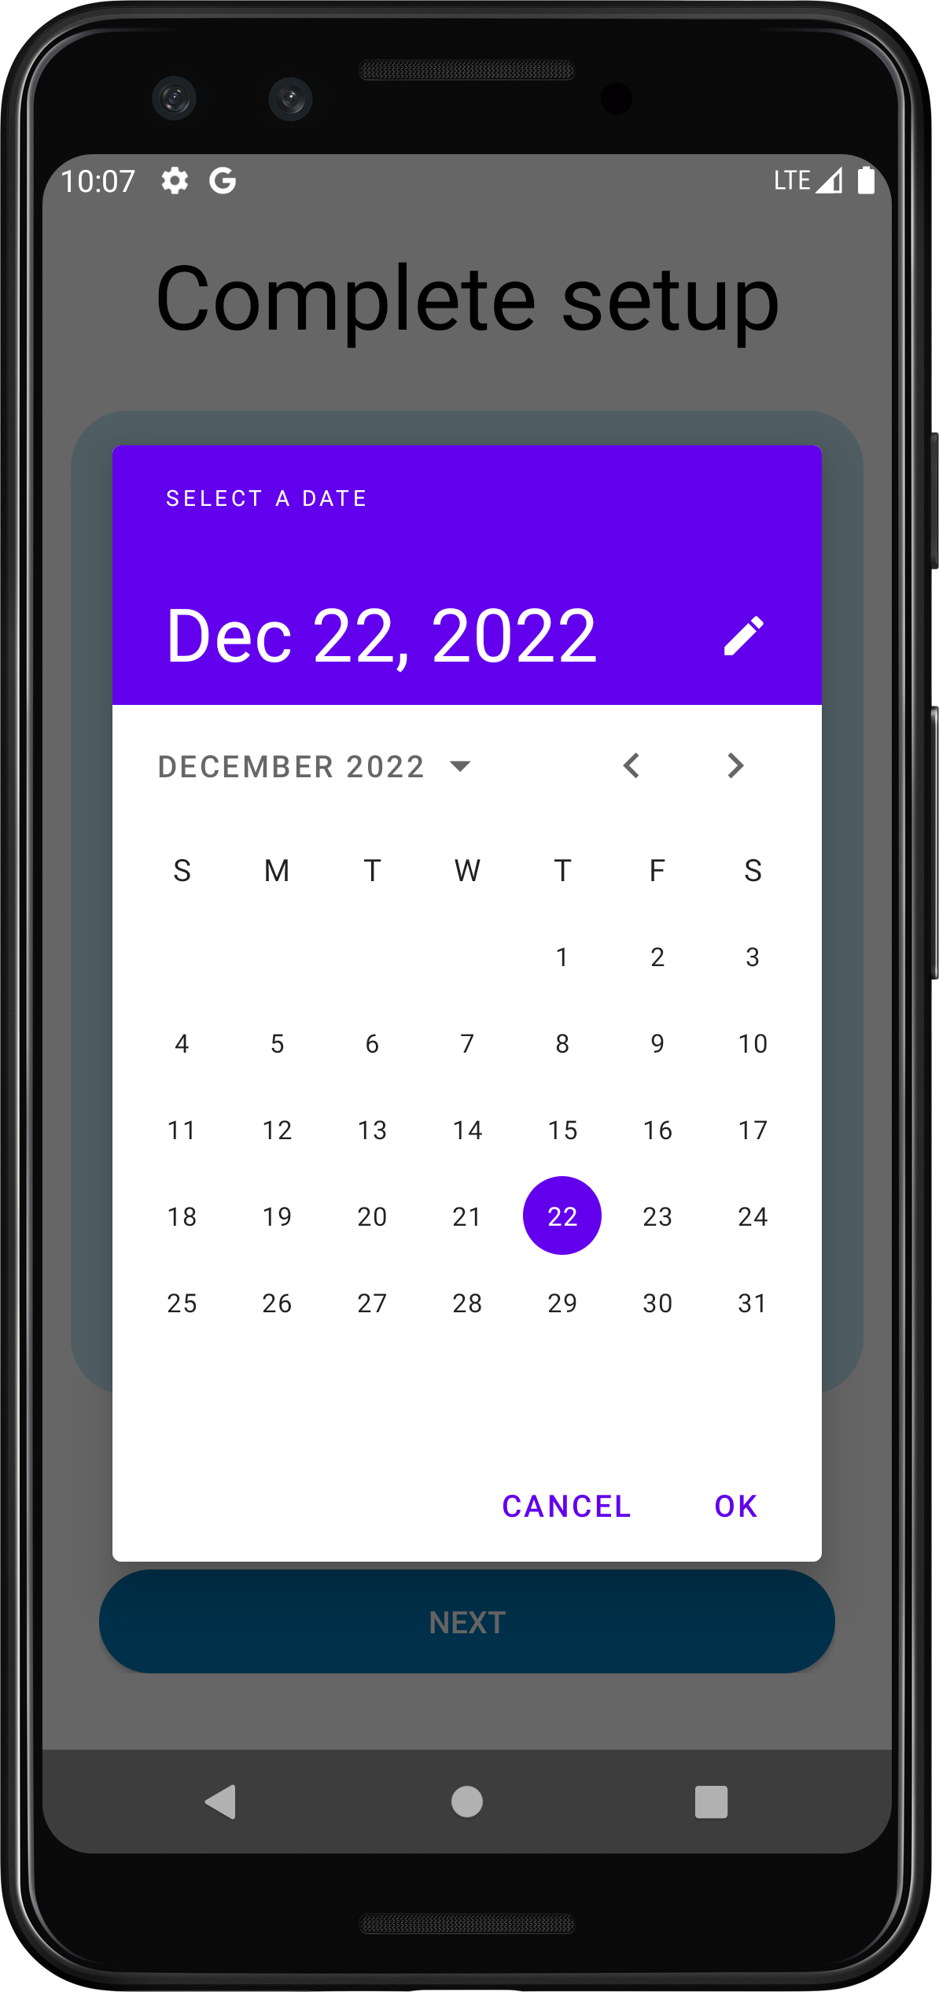
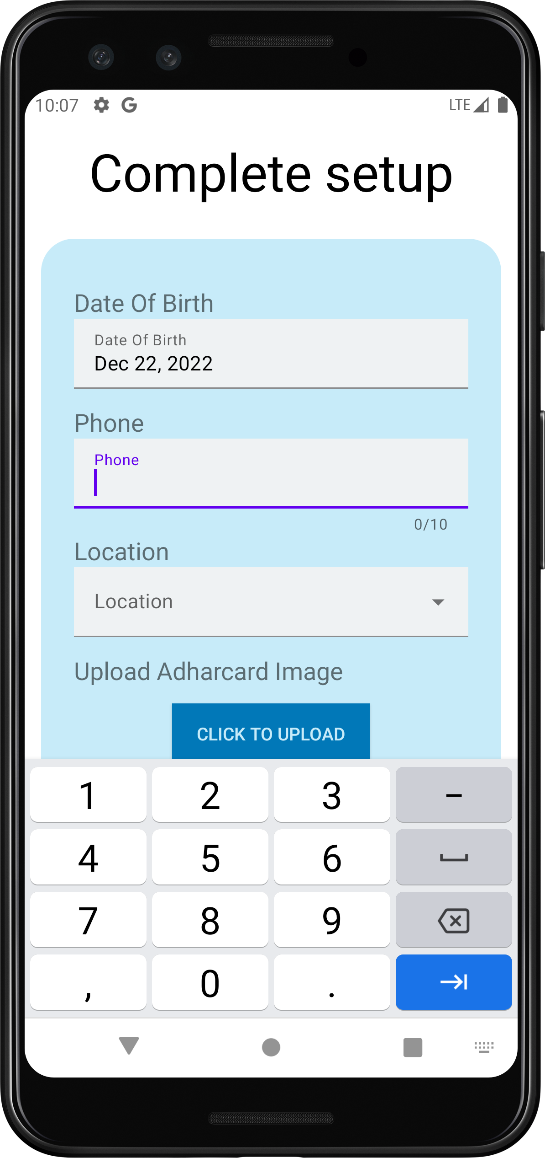
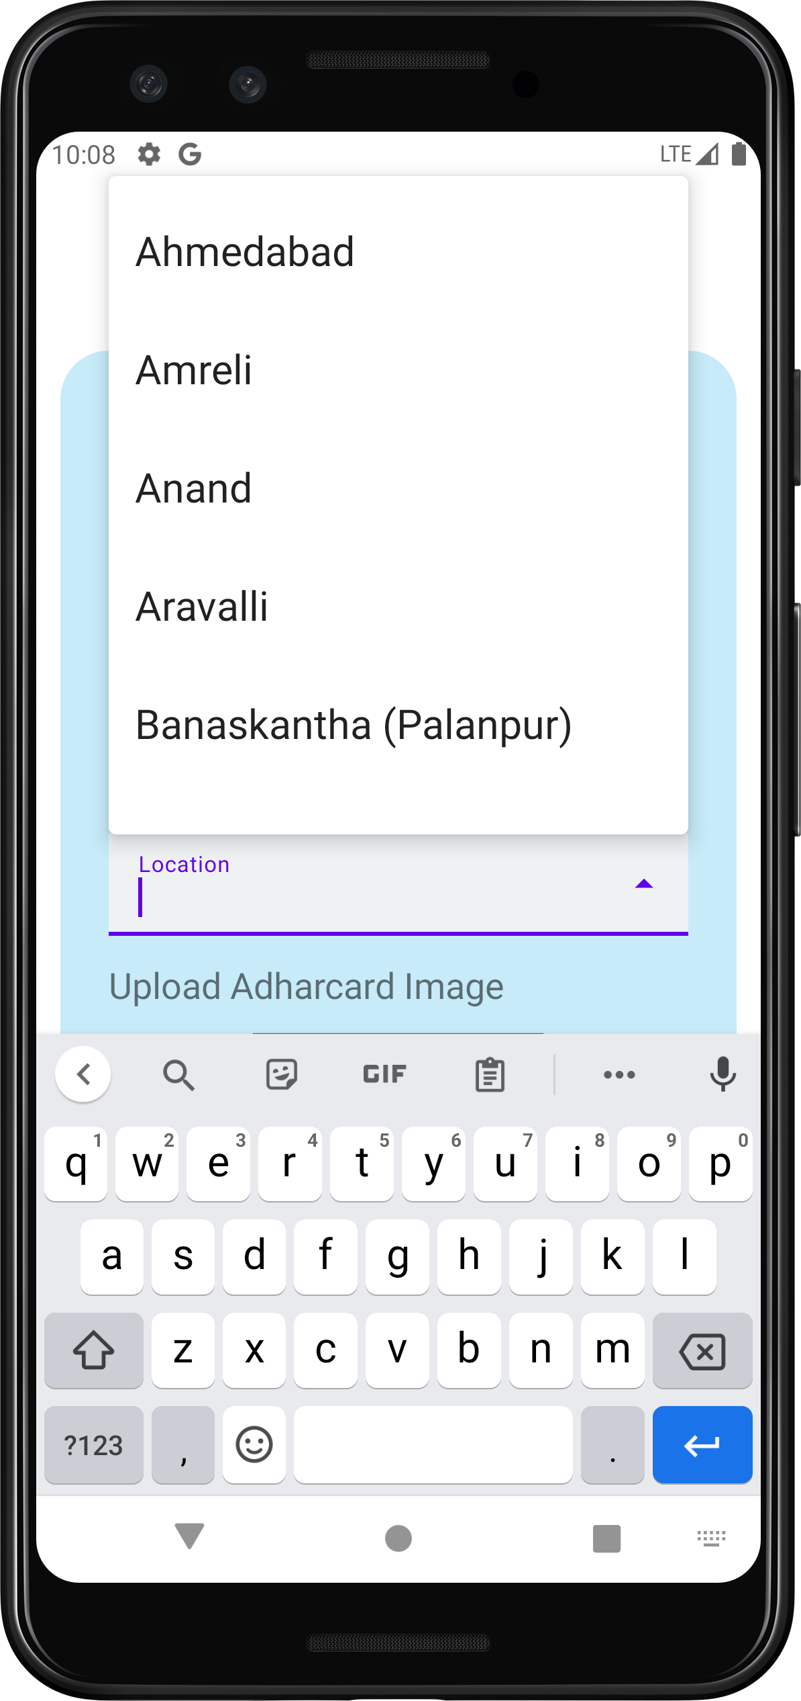
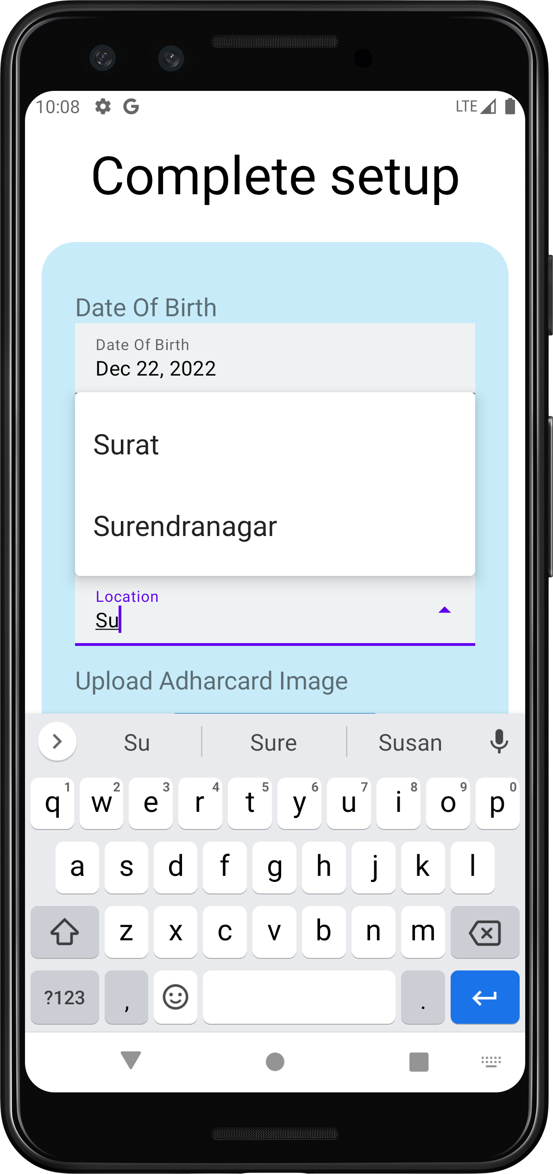
Sign Up Activity2

Slide 8
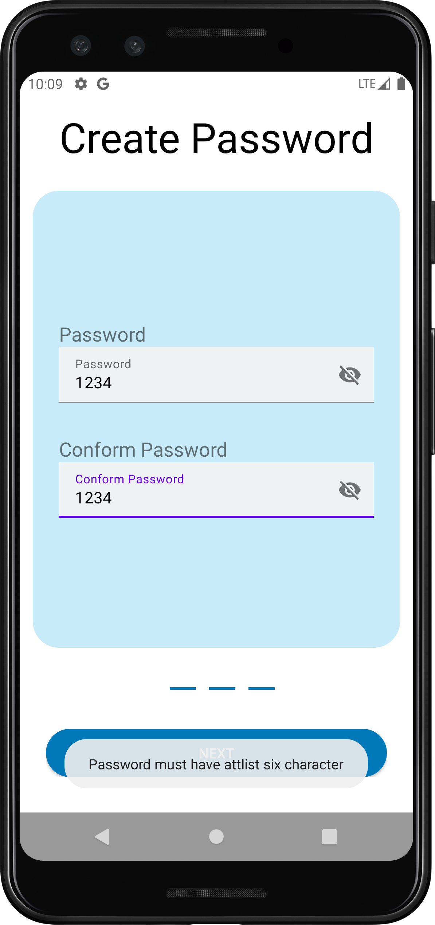
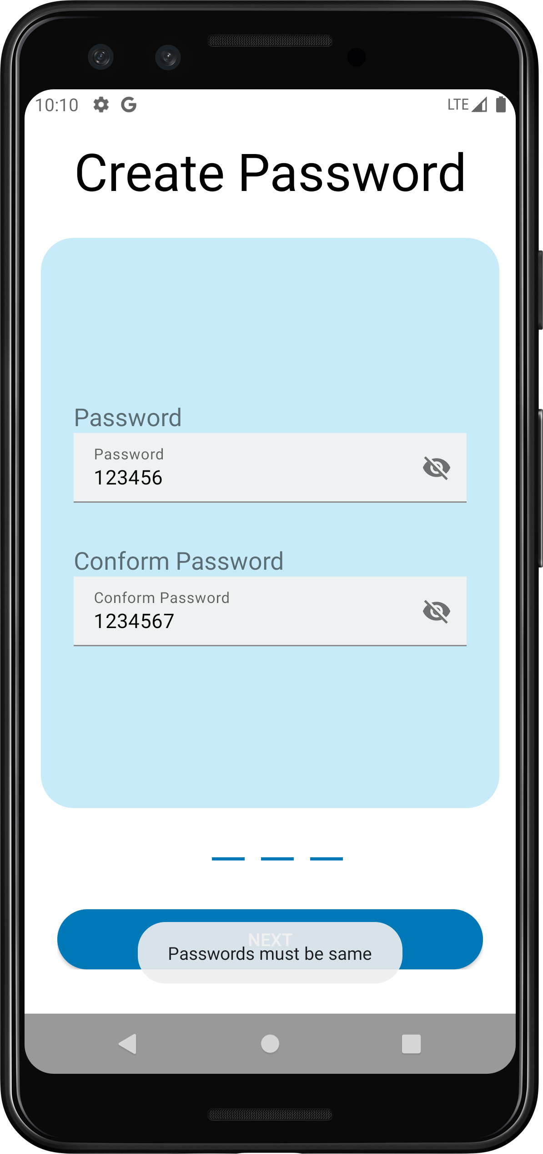
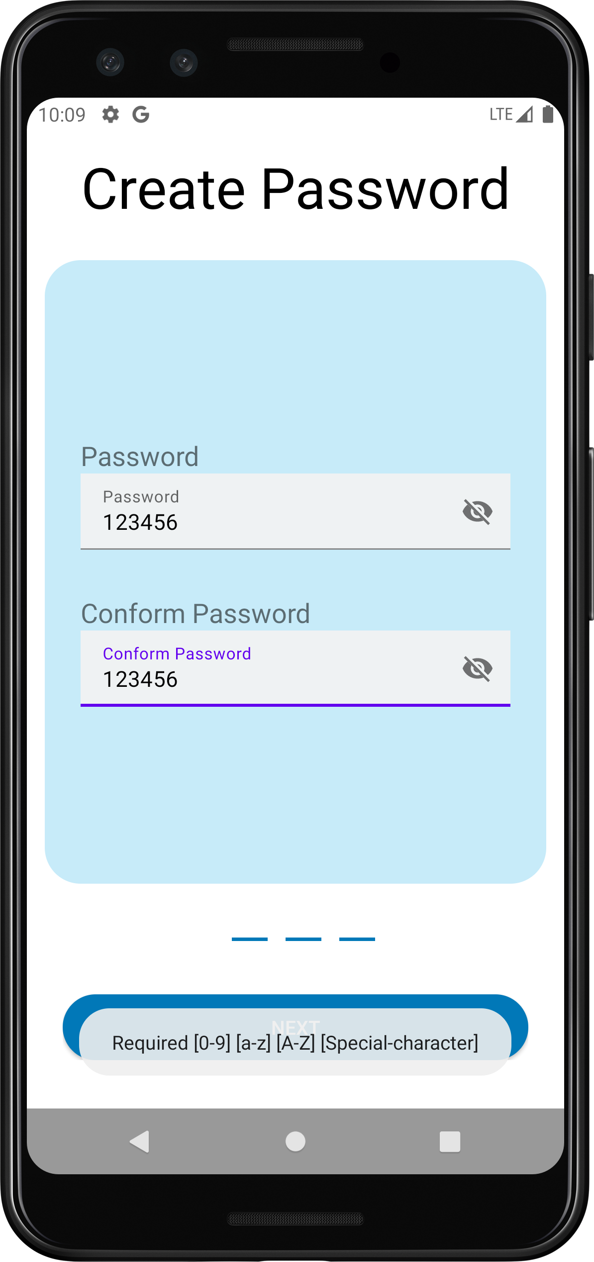
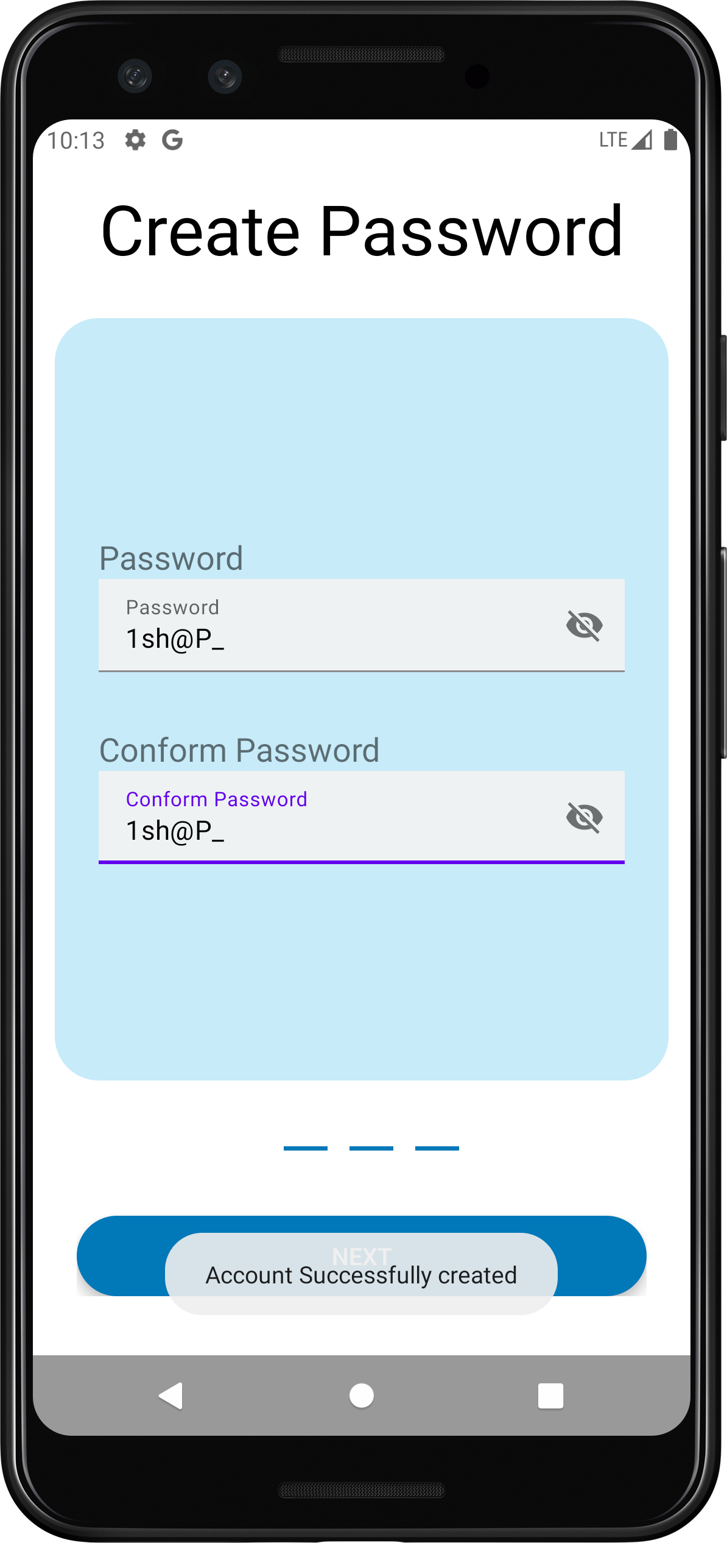
Sign Up Activity3

Slide 9
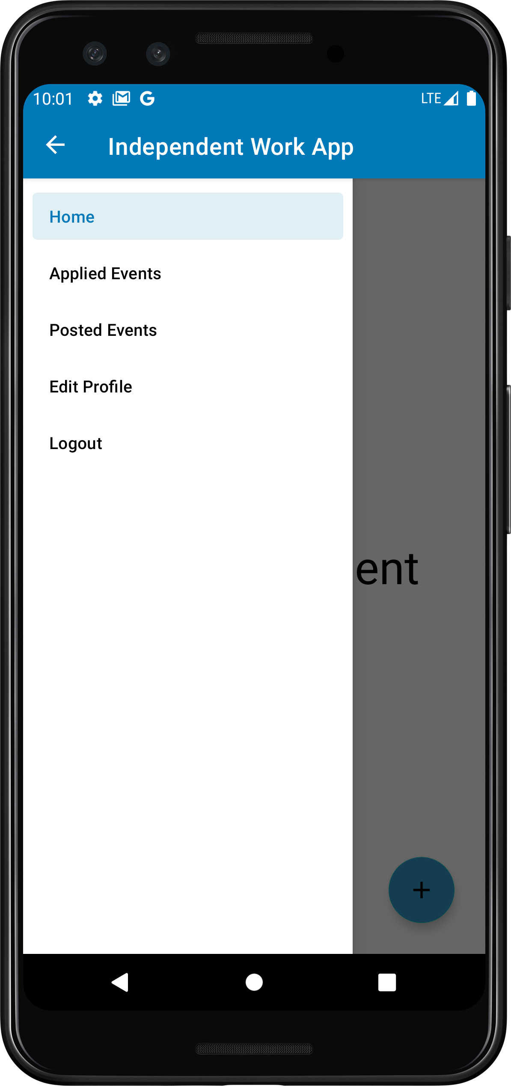
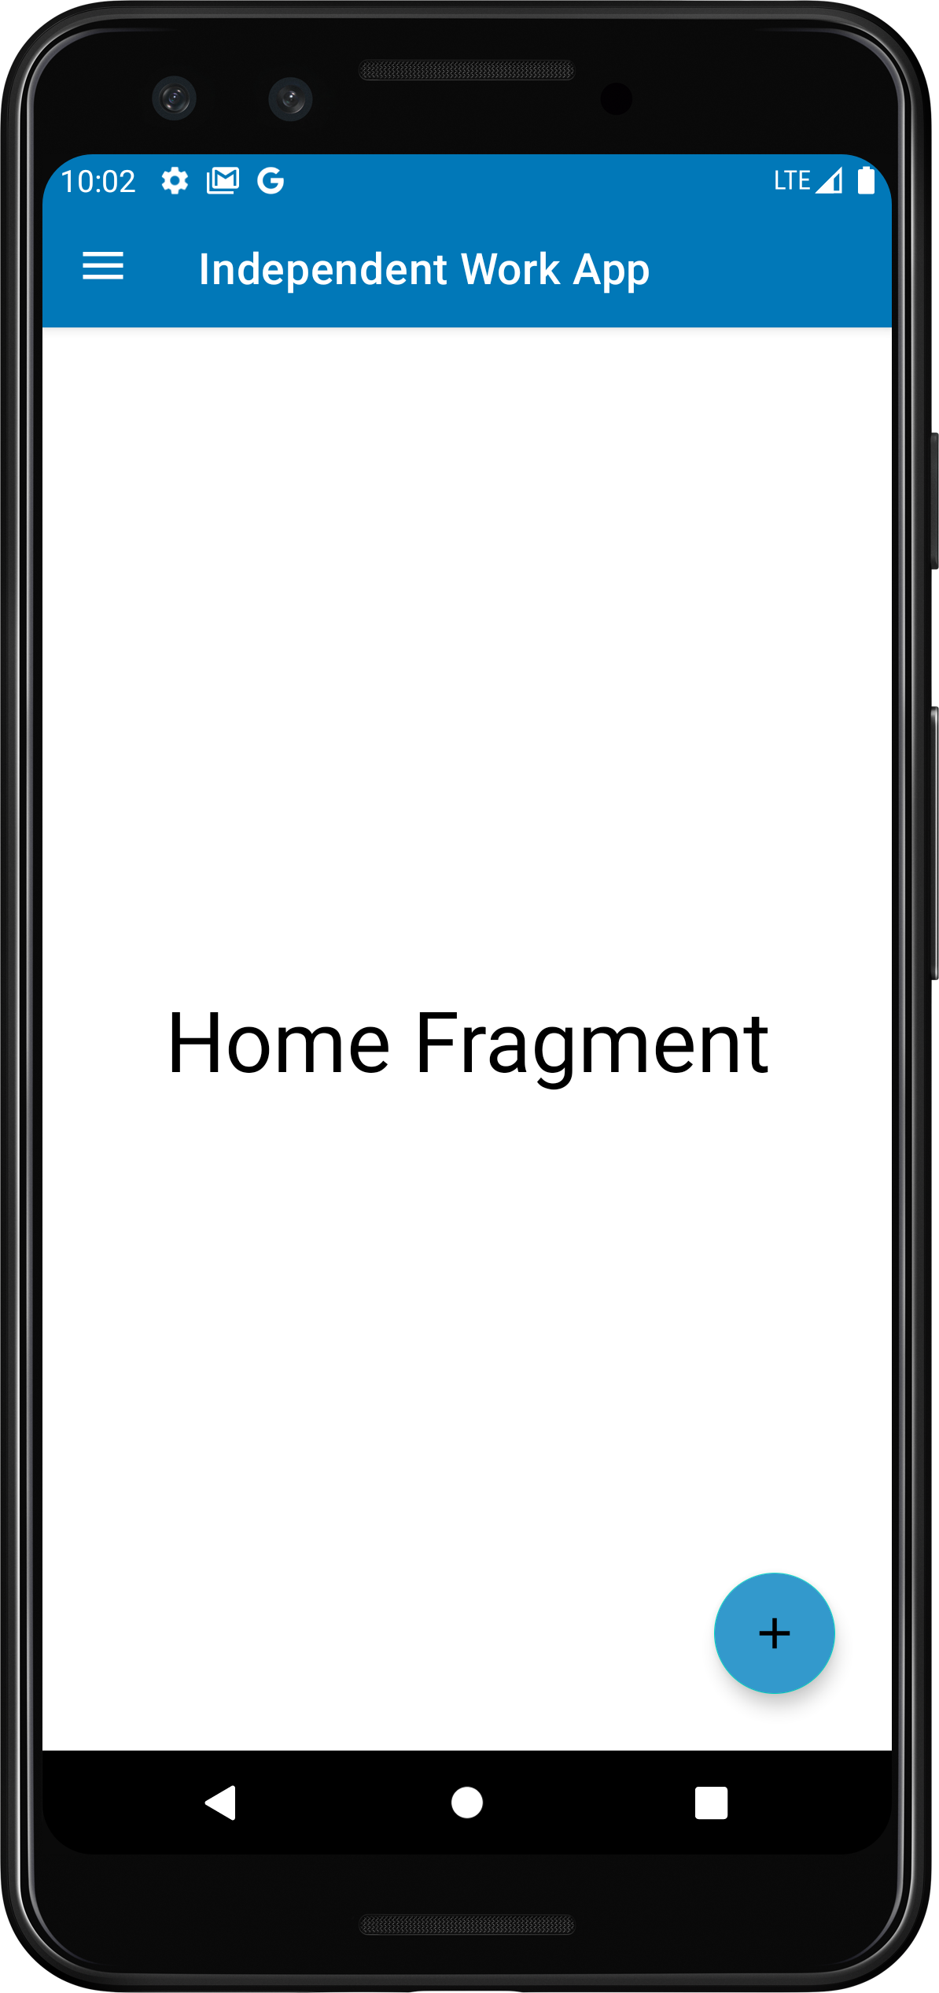
Main Activity(Home Fregement)

Slide 10
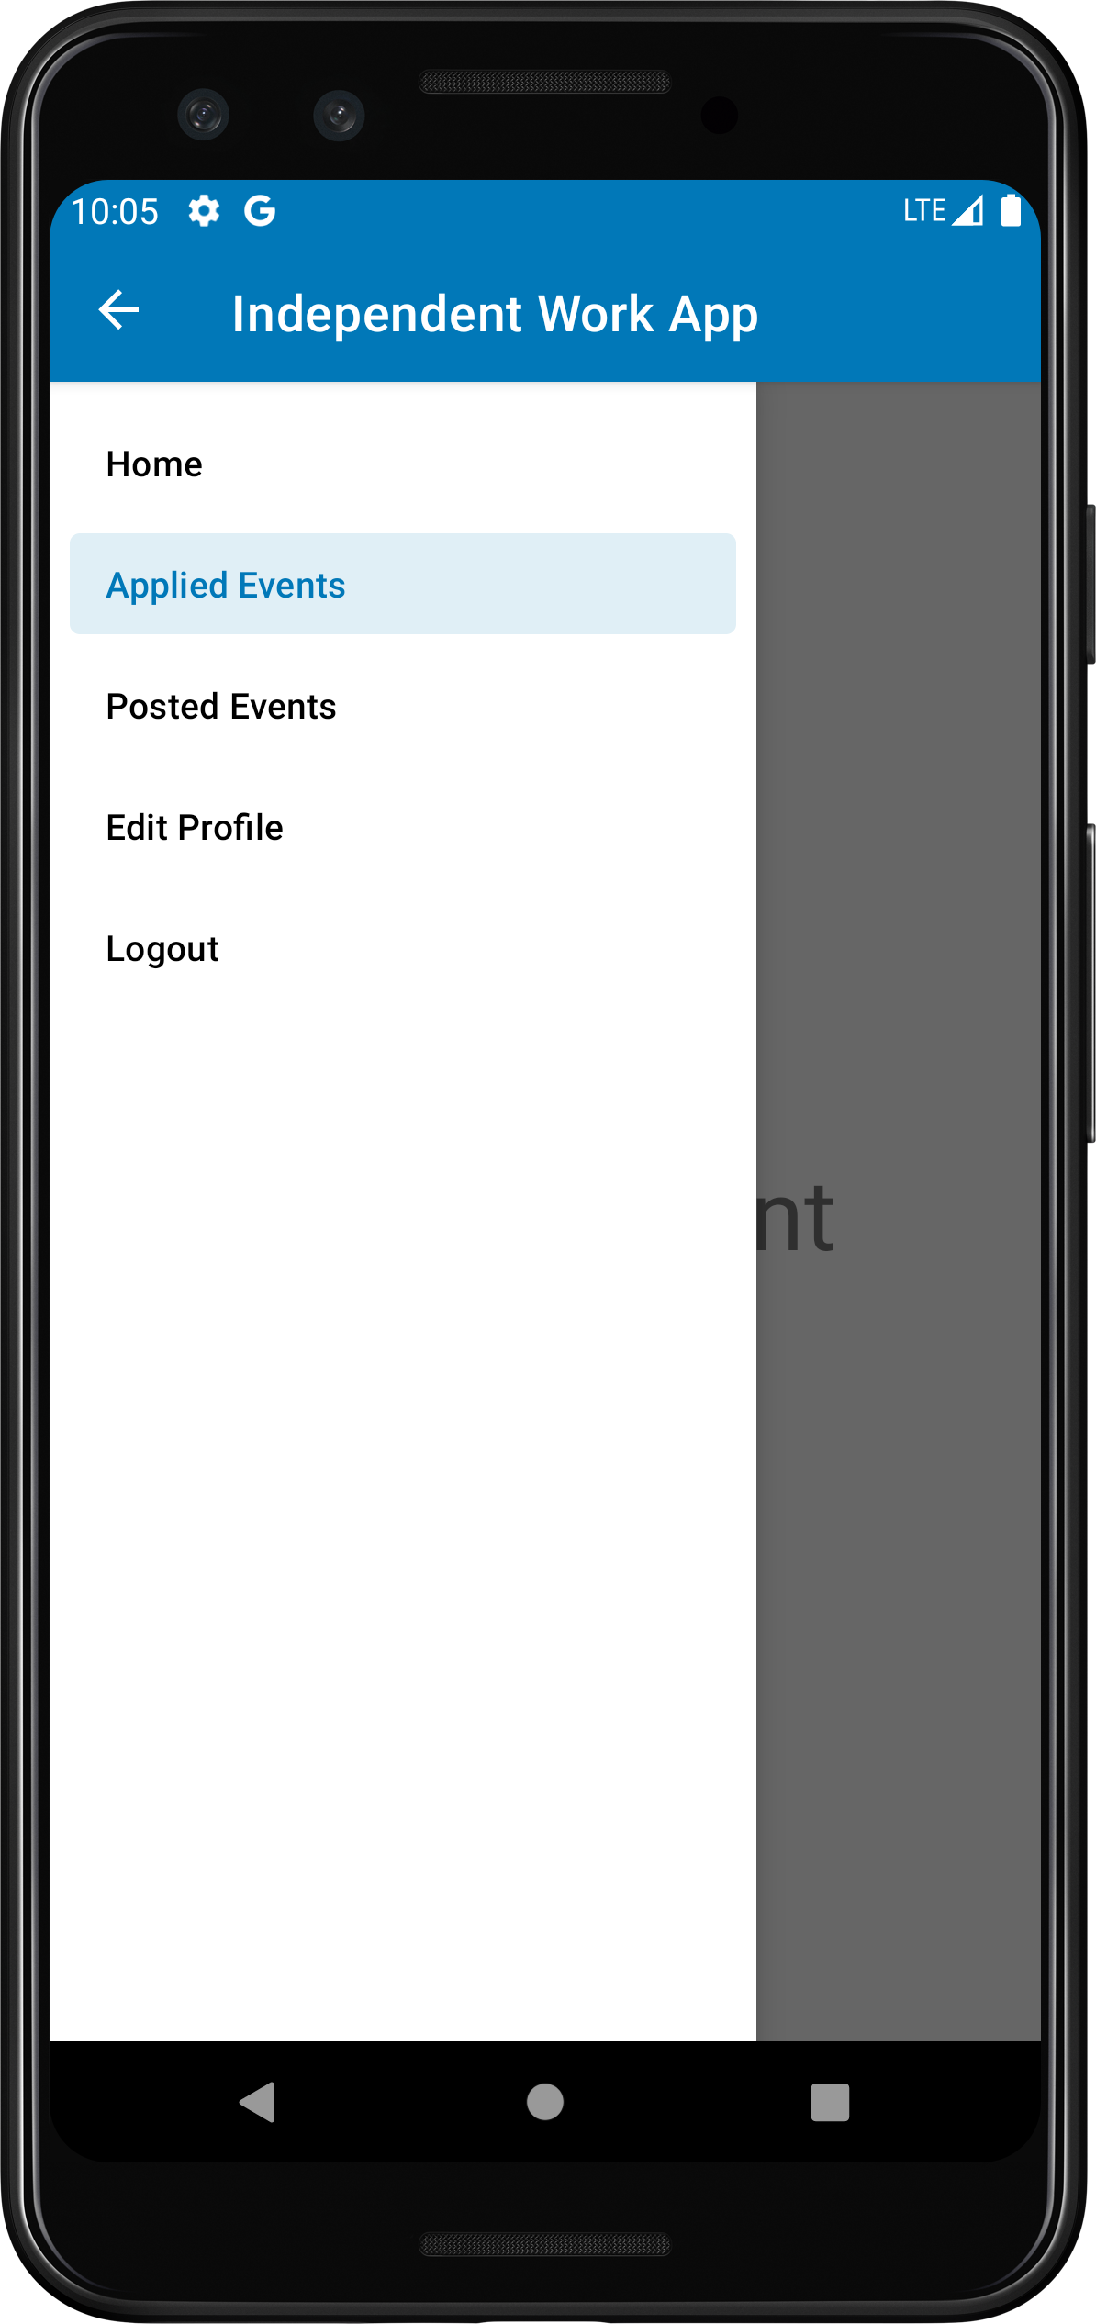
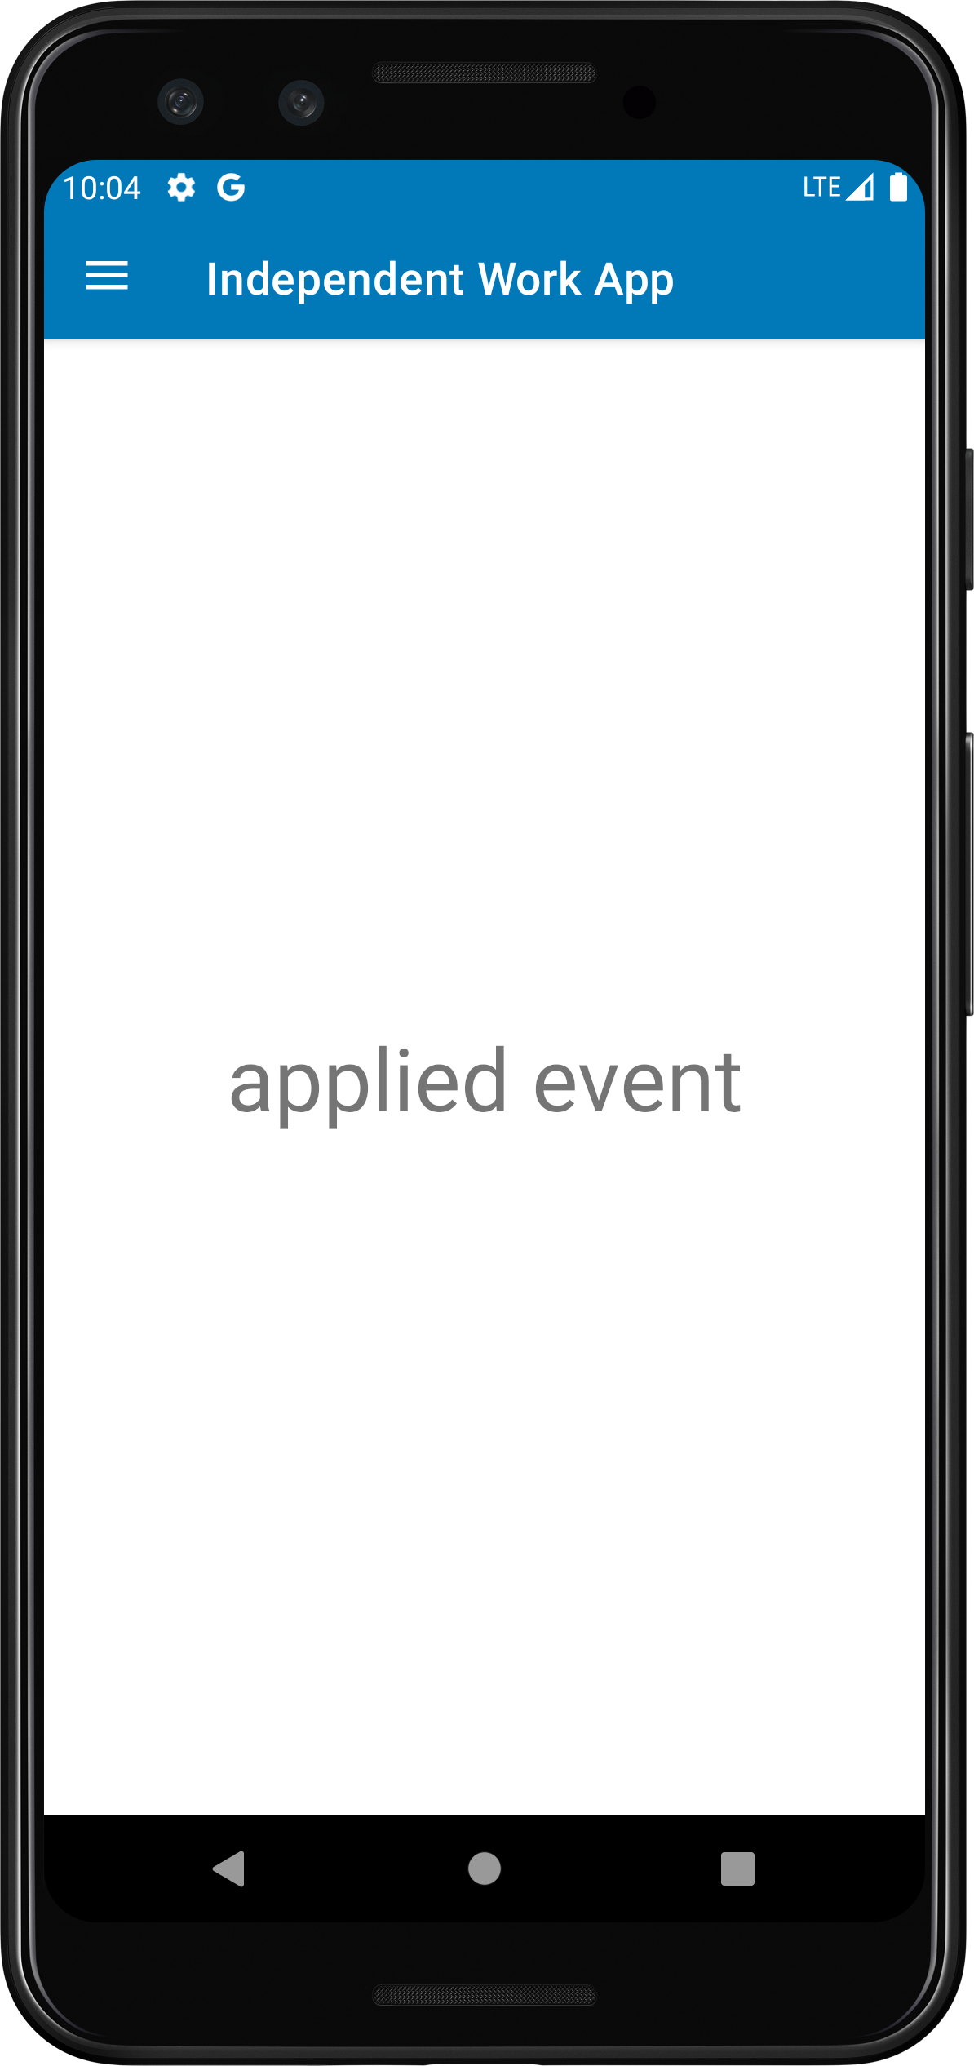
Main Activity(Applied Event Fregement)

Slide 11
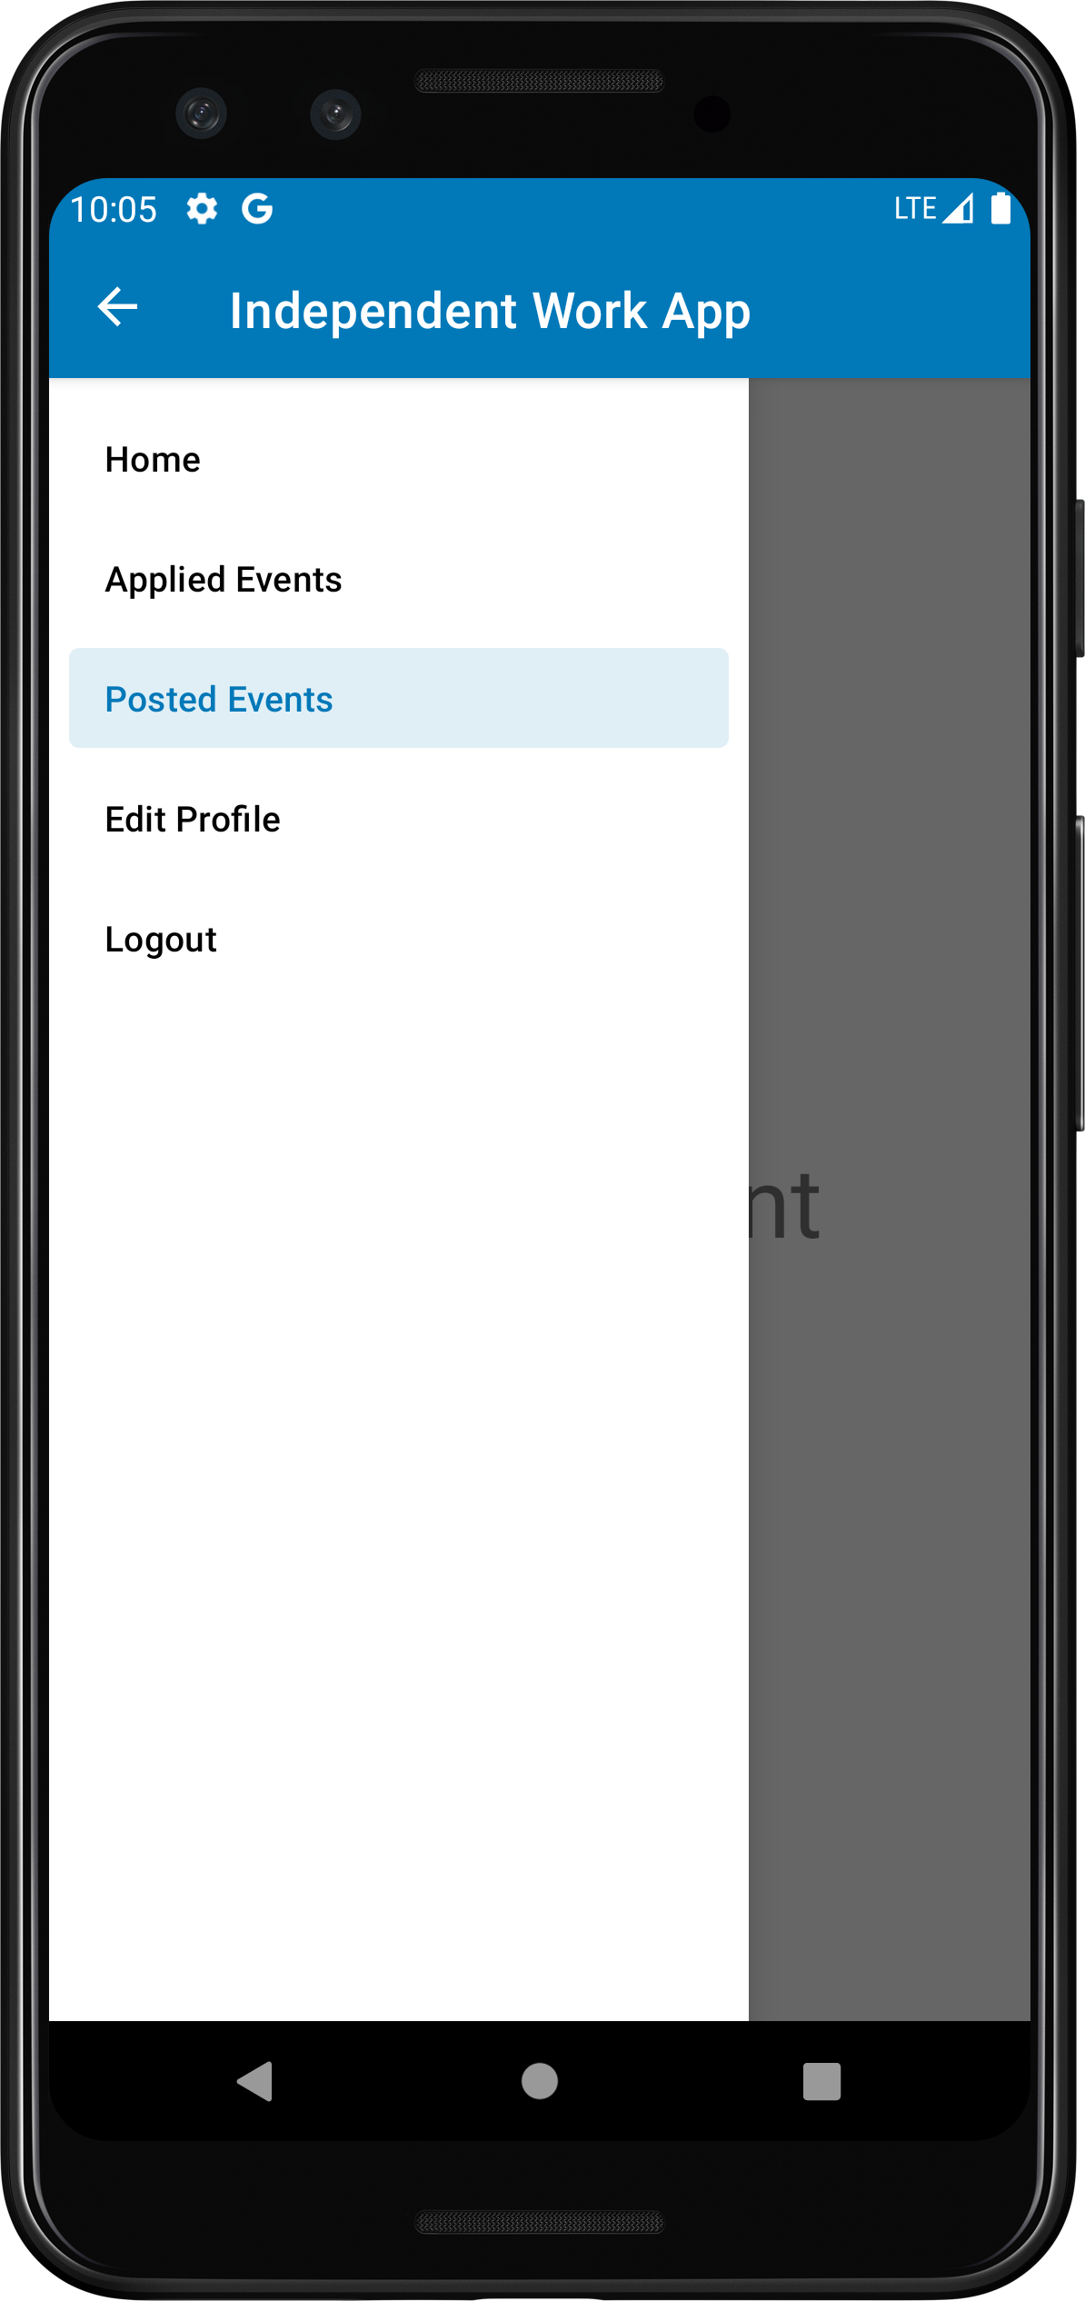
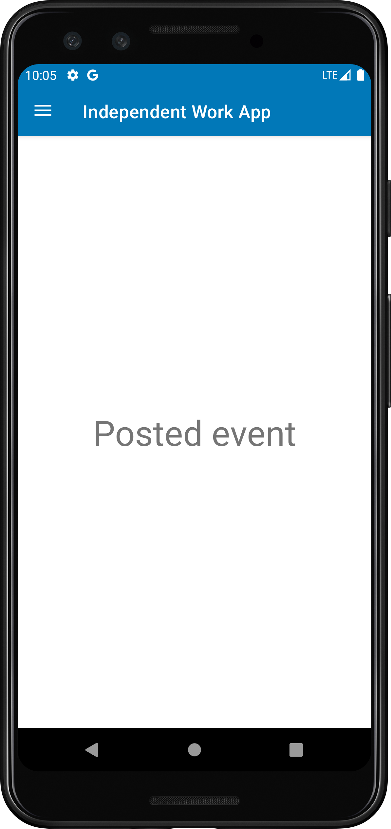
Main Activity(Posted Event Fregement)

Slide 12
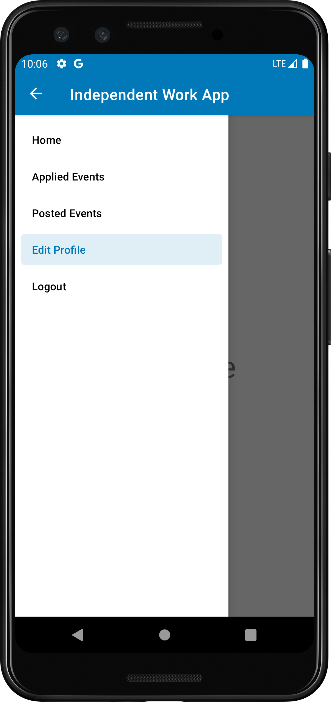
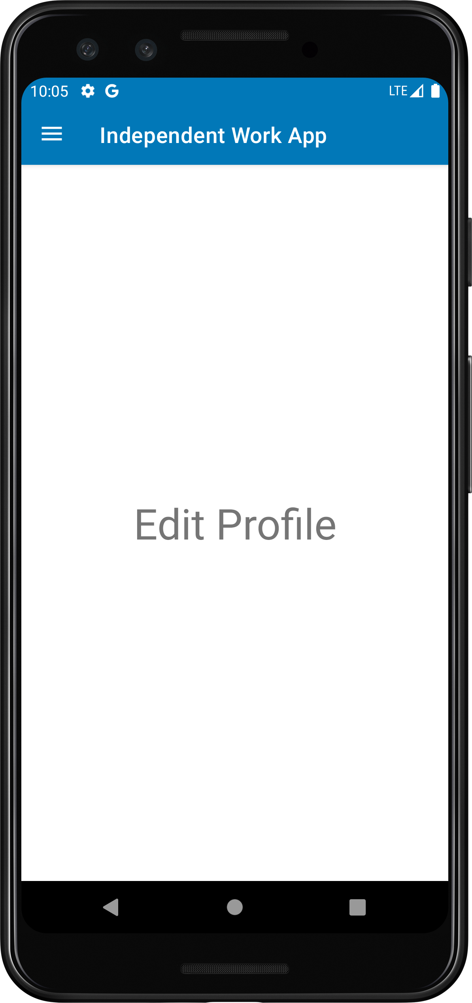
Main Activity(Edit Profile Fregement)

Slide 13
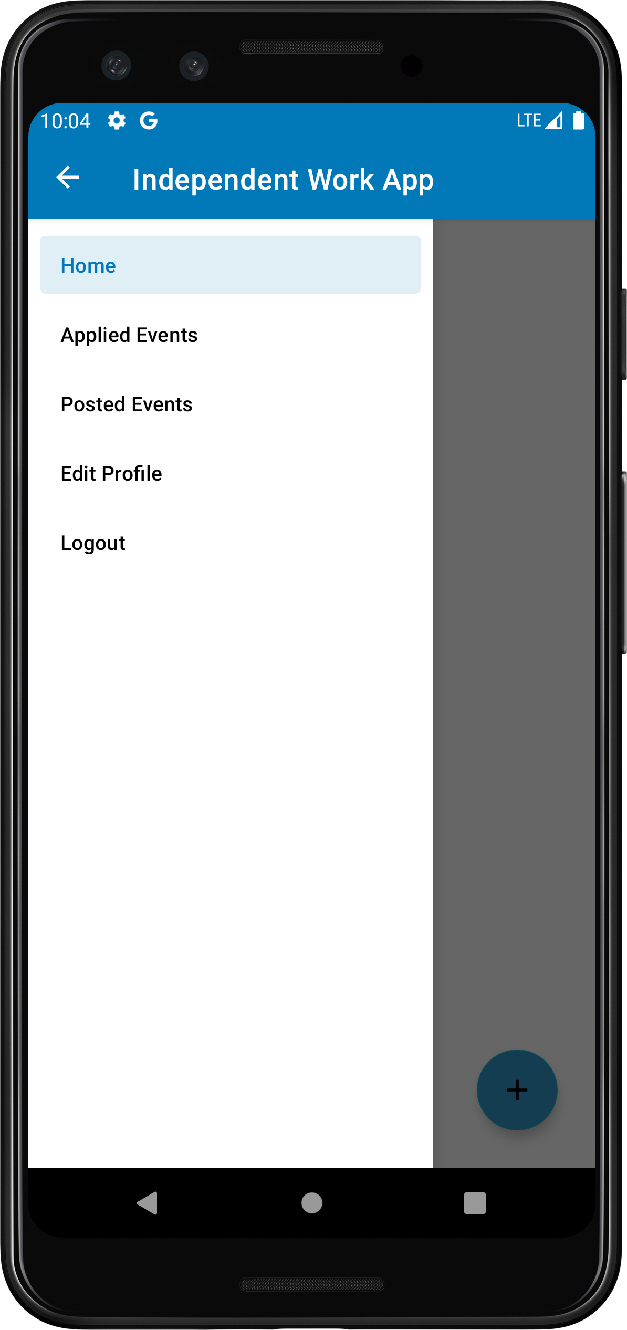
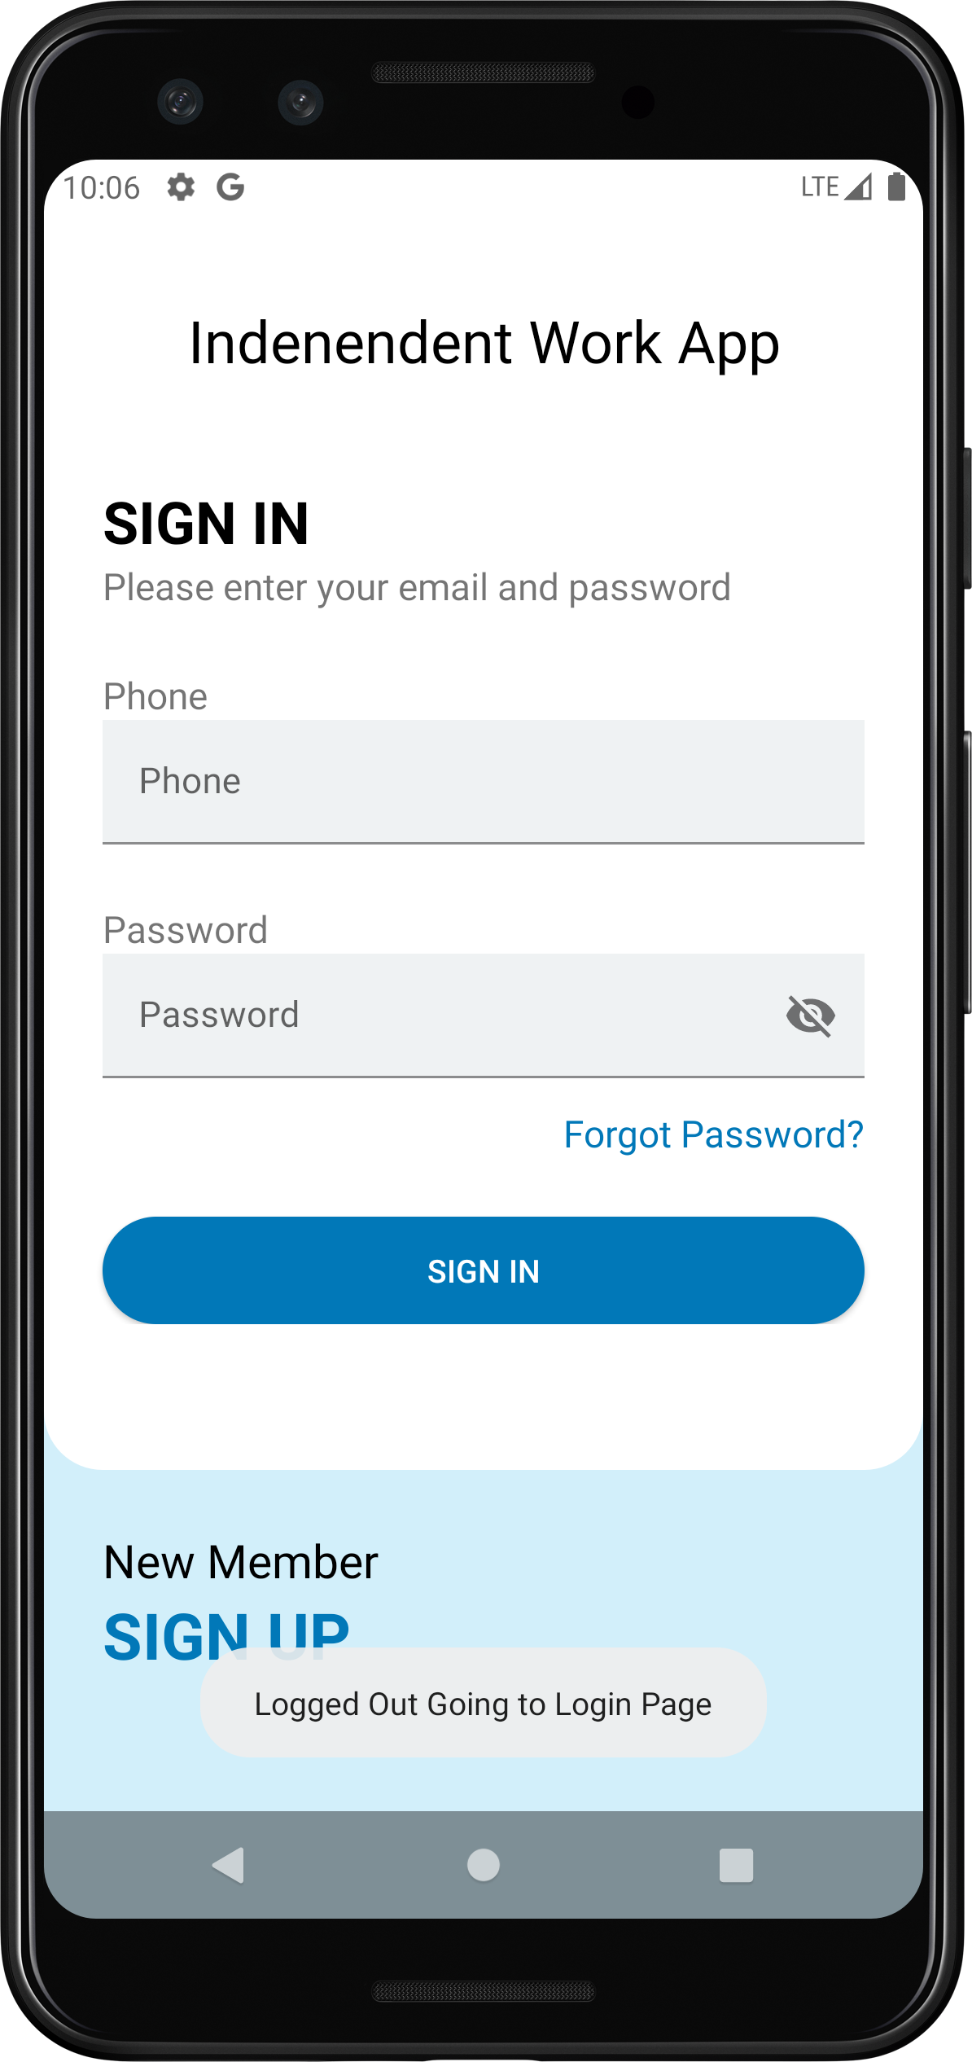
Main Activity(Logout)

Slide 14
Part Ⅱ
Results of work

Slide 15
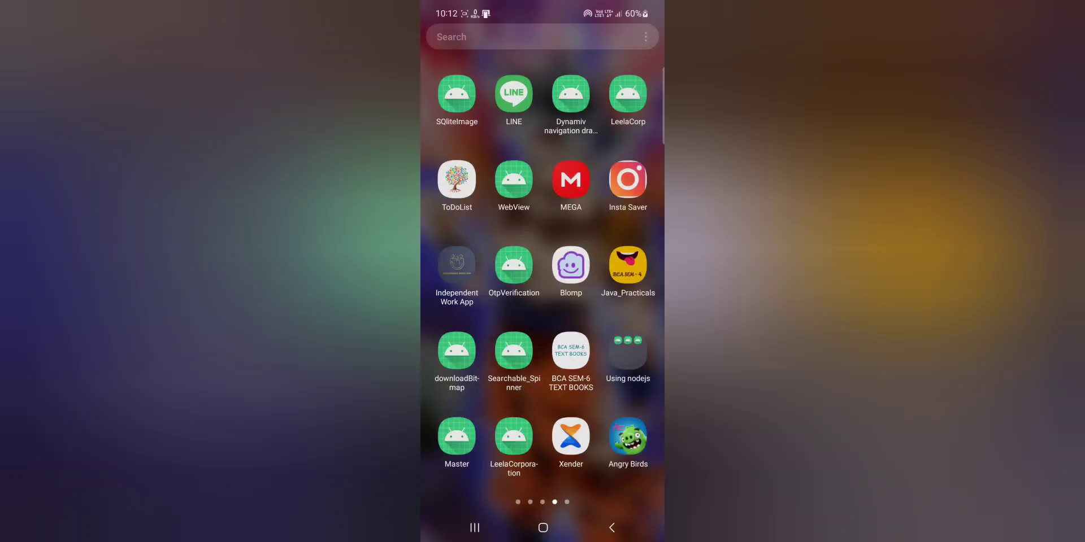

Screen Recording

Slide 16
Thank you for watching
Reporter:Pragnesh Koli
Reporter:Krushali
Reporter:Krupesh
Department:B.C.A.
Department:B.C.A.
Department:B.C.A.

